Slide 1
FUNDAMENTALS OF THE ANALYSIS OF ALGORITHM EFFICIENCY
ALGORITHM ANALYSIS
<<professor>>
Computer Science Department

Slide 2
CAST OF CHARACTERS
Programmer
Client
Theoretician
STUDENTS
Computer Science Department
Slide <number> of 56

Slide 3
ANALYSIS OF ALGORITHMS
Analysis of algorithms and data structure is the major force that drives the design of
solutions.
• there are many solutions to a problem: pick the one that is the most efficient
• how to compare various algorithms? Analyze algorithms.
Computer Science Department
Slide <number> of 56

Slide 4
ANALYSIS OF ALGORITHMS
Analysis of algorithms and data structure is the major force that drives the design of
solutions.
Algorithm analysis: analyze the cost of the algorithm
cost = time: How much time does this algorithm require?
Computer Science Department
Slide <number> of 56

Slide 5
ANALYSIS OF ALGORITHMS
Analysis of algorithms and data structure is the major force that drives the design of solutions.
The primary efficiency measure for an algorithm is time, all concepts that we discuss for time analysis apply also to space analysis
cost = space:
How much space (i.e. memory) does this algorithm require?
cost = space + time
Computer Science Department
Slide <number> of 56

Slide 6
ANALYSIS OF ALGORITHMS
Running time of an algorithm
• increases with input size, on inputs of same size, can vary from input to input
e.g.: linear search an un-ordered array
• depends on hardware
  • CPU speed, hard-disk, caches, bus, etc
  • depends on OS, language, compiler, etc
Computer Science Department
Slide <number> of 56

Slide 7


REASONS TO ANALYZE ALGORITHM
Predict performance
Compare algorithms
Provide guarantees
Understand theoretical basis
PRIMARY PRACTICAL REASON: avoid performance bugs
Client gets poor performance because programmer did not understand performance characteristics
Computer Science Department
Slide <number> of 56

Slide 8

CHALLENGE
Will my program be able to solve a
large practical input?
Insight [knuth 1970s] Use scientific method to understand performance
Why is my program so slow?
Why does it run out of memory
Computer Science Department
Slide <number> of 56

Slide 9
SCIENTIFIC METHOD APPLIED TO ANALYSIS OF ALGORITHMS
Framework for predicting performance and comparing algorithms.
SCIENTIFIC METHODS:
Observe some features of the natural world
Hypothesize a model that is consistent with the observations
Predict events using the hypothesis
Verify the predictions by making further observations
Validate by repeating until the hypothesis and observation agree.
Computer Science Department
Slide <number> of 56

Slide 10
SCIENTIFIC METHOD APPLIED TO ANALYSIS OF ALGORITHMS
Framework for predicting performance and comparing algorithms.
PRINCIPLES
Experiments must be reproducible
Hypothesis must be falsifiable.
Computer Science Department
Slide <number> of 56

Slide 11
GIVEN N DISTINCT INTEGERS, HOW MANY TRIPLES SUM TO EXACTLY ZERO?
% more 8 ints.txt
8
-40 -20 -10 40 0 10 5
% java ThreeSum 8ints.txt
4
 | A[i] | A[j] | A[k] | sum
1 | 30 | -40 | 10 | 0
2 | 30 | 20 | -10 | 0
3 | -40 | 40 | 0 | 0
4 | -10 | 0 | 10 | 0
Context. Deeply related to problems in computational geometry
Computer Science Department
Slide <number> of 56

Slide 12
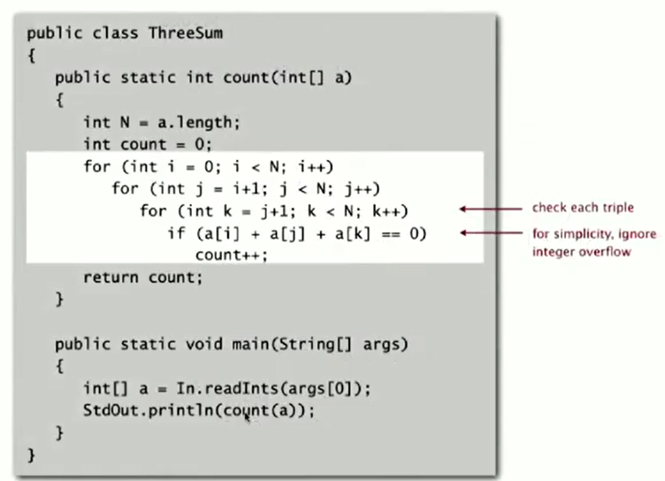
Computer Science Department
Slide <number> of 56

Slide 13
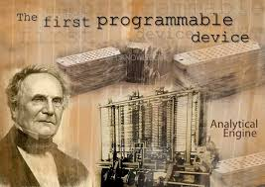
RUNNING TIME
“As soon as an Analytic Engine exists, it will necessarily guide the future course of the science. Whenever any result is sought by its aid, the question will arise- By what course of calculation can these results be arrived at by the machine in the shortest time?”
Charles Babbage (1864)
Computer Science Department
Slide <number> of 56

Slide 14

MEASURING THE RUNNING TIME
How to time a program
-Manual
-Automatic
Computer Science Department
Slide <number> of 56

Slide 15
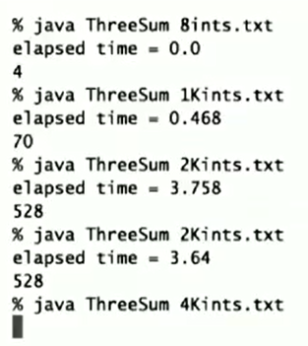
EMPIRICAL ANALYSIS
Run the program for various input sizes and measure running time
Computer Science Department
Slide <number> of 56

Slide 16
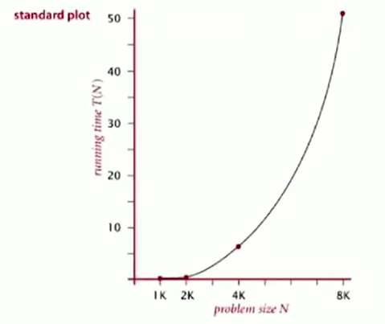
DATA ANALYSIS
Standard plot. Plot running time T(N) vs input size N.
Computer Science Department
Slide <number> of 56

Slide 17
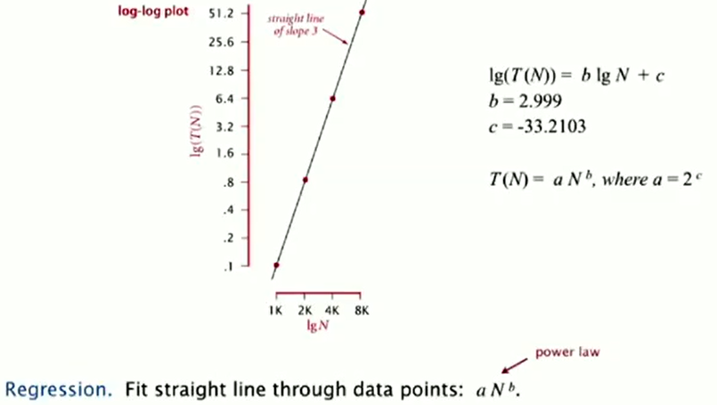
DATA ANALYSIS
Log-log plot. Plot running time T(N) vs input size N using log-log scale.
Computer Science Department
Slide <number> of 56

Slide 18
EXPERIMENTAL ALGORITHMICS
System independent effects.
  Algorithm
  Input data
System dependent effects
Hardware: cpu, memory, cache,…
Software: compiler, interpreter, garbage collector,…
System: OS, network, other apps,…
Bad news. Difficult to get precise measurements.
Good news. Much easier and cheaper than other services
Determines exponent b in power law
Determines constant a in power law
Computer Science Department
Slide <number> of 56

Slide 19
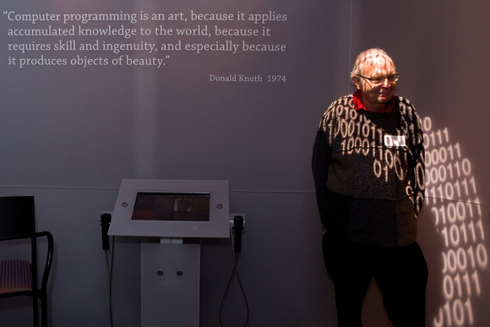
MATHEMATICAL MODELS
FOR RUNNING TIMES
Total running time: sun of cost x frequency for all operations
Need to analyze program to determine set of operations.
Cost depends on machine , compiler
Frequency depends on algorithm, input data
In principle, accurate mathematical modes are available
Computer Science Department
Slide <number> of 56

Slide 20
COST OF BASIC OPERATIONS
OPERATION | EXAMPLE | NANOSECONDS
integer add | a+b | 2.1
integer multiple | a * b | 2.4
integer divide | a / b | 5.4
floating-point add | a + b | 4.6
floating-point multiply | a * b | 4.2
floating-point divide | a / b | 13.5
sine | math.sin(theta) | 91.3
arctangent | math.atan2(y,x) | 129.0
Runnig OS X on Macbook Pro 2.2Ghz with 2GB RAM
Computer Science Department
Slide <number> of 56

Slide 21
ANALYSIS OF ALGORITHMS
ISSUES:
  correctness
  time efficiency
  space efficiency
  optimality
APPROACHES:
  theoretical analysis
  empirical analysis
Computer Science Department
Slide <number> of 56

Slide 22
THEORETICAL ANALYSIS OF
TIME EFFICIENCY
Time efficiency is analyzed by determining the number of repetitions of the basic operation as a function of input size
Basic operation
  the operation that contributes the most towards the running time of the algorithm
Computer Science Department
Slide <number> of 56

Slide 23
THEORETICAL ANALYSIS OF
TIME EFFICIENCY
T(n) ≈ cop C(n)
Where
  T(n) = Running Time
  Cop = execution time for basic operation or cost
  C(n) = number of times basic operation is executed
Note: Different basic operation may cost differently!
Computer Science Department
Slide <number> of 56

Slide 24
INPUT SIZE AND BASIC OPERATION EXAMPLES
PROBLEM | INPUT SIZE MEASURE | BASIC OPERATION
Searching for key in a list of n items | Number of list’s items, i.e. n | Key comparison
Multiplication of two matrices | Matrix dimensions or total number of elements | Multiplication of two numbers
Checking primality of a given integer n | n’size = number of digits (in binary representation) | Division
Typical graph problem | #vertices and/or edges | Visiting a vertex or traversing an edge
Computer Science Department
Slide <number> of 56

Slide 25
EMPIRICAL ANALYSIS OF
TIME EFFICIENCY
Select a specific (typical) sample of inputs
Use physical unit of time (e.g., milliseconds)
or
Count actual number of basic operation’s executions
Analyze the empirical data
Computer Science Department
Slide <number> of 56

Slide 26
Best Case, Average Case, Worst Case
For some algorithms, efficiency depends on form of input:
Worst case: C_{worst}(n) – maximum over inputs of size n
Best case: C_{best}(n) – minimum over inputs of size n
Average case:C_{avg}(n) – “average” over inputs of size n
  Number of times the basic operation will be executed on typical input
  NOT the average of worst and best case
  Expected number of basic operations considered as a random variable under some assumption about the probability distribution of all possible inputs. So, avg = expected under uniform distribution.
Computer Science Department
Slide <number> of 56

Slide 27
Example: Sequential Search
Algorithm SequentialSearch(A[0..n-1],k)
INPUT: List of size N. Target value T OUTPUT: Position of T in the list I
BEGIN
Set FOUND to false
Set I to 0
2. While (I<=N) and (FOUND is false)
If List [I] = T
FOUND = true
Else
I=I+1
END
3. If FOUND is false
T is not present in List.
END
Worst Case?
Best Case?
Average Case?
n key comparisons
(n+1)/2, assuming K is in A
Computer Science Department
Slide <number> of 56

Slide 28
TYPES OF FORMULAS FOR BASIC OPERATION’S COUNT
Exact formula
e.g., C(n) = n(n-1)/2
Formula indicating order of growth with specific multiplicative constant
e.g., C(n) ≈ 0.5 n²
Formula indicating order of growth with unknown multiplicative constant
e.g., C(n) ≈ cn²
Computer Science Department
Slide <number> of 56

Slide 29
ORDER OF GROWTH
Most important: Order of growth within a constant multiple as n→∞
Example:
  How much faster will algorithm run on computer that is twice as fast?
  How much longer does it take to solve problem of double input size?
Computer Science Department
Slide <number> of 56
Notes:
Example: cn²
how much faster on twice as fast computer? (2)
how much longer for 2n? (4)

Slide 30
VALUES OF SOME IMPORTANT FUNCTION AS N-> ∞
n | log₂n | n | nlog₂n | n₂ | n₃ | 2^{n} | n!
10 | 3.3 | 10¹ | 3.3.10¹ | 10² | 10³ | 10³ | 3.6.10⁶
10² | 6.6 | 10² | 6.6.10² | 10⁴ | 10⁶ | 1.3.10³⁰ | 9.3.10¹⁵⁷
10³ | 10 | 10³ | 1.0.10⁴ | 10⁶ | 10⁹
10⁴ | 13 | 10⁴ | 1.3.10⁵ | 10⁸ | 10¹²
10⁵ | 17 | 10⁵ | 1.7.10⁶ | 10¹⁰ | 10¹⁵
10⁶ | 20 | 10⁶ | 2.0.10⁷ | 10¹² | 10¹⁸
Values (some approximate) of several functions important for analysis of algorithm
Computer Science Department
Slide <number> of 56

Slide 31
Example
int sum(int * data, int N) {
int result = 0; //1
for (int i = 0; i <N; i++) { //2
result += data[i]; //3
}
return result; //4
}
Computer Science Department
Slide <number> of 56

Slide 32
ASYMPTOTIC ORDER OF GROWTH
A way of comparing functions that ignores constant factors and small input sizes (because?)
O(g(n)): class of functions f(n) that grow no faster than g(n)
Θ(g(n)): class of functions f(n) that grow at same rate as g(n)
Ω(g(n)): class of functions f(n) that grow at least as fast as g(n)
Computer Science Department
Slide <number> of 56

Slide 33
BIG OH
Definition: f(n) is in O(g(n)), denoted f(n) ∈ O(g(n)), if order of growth of f(n) ≤ order of growth of g(n) (within constant multiple), i.e., there exist positive constant c and non-negative integer n₀ such that
f(n) ≤ c g(n) for every n ≥ n₀
Examples:
10n is in O(n)
5n+20 is in O(n)
Computer Science Department
Slide <number> of 56

Slide 34
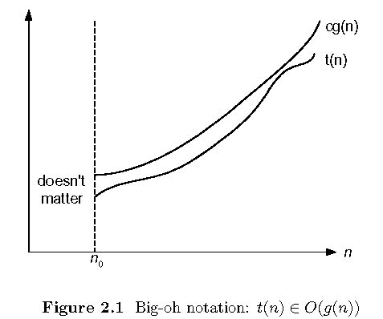
BIG OH
Computer Science Department
Slide <number> of 56

Slide 35
Expression | Dominant Term(s) | O(…)
5 + 0.001n³ + 0.025n
0.3n + 5n^{1.5} + 2.5n^{1.75}
n² log ₂n + n(log ₂ n)²
n log₃ n + n log₂ n
3 log₈ n + log₂ log₂ log₂ n
100n +0.01n²
2n + n ^{0.5} + 0.5n^{1.25}
Computer Science Department
Slide <number> of 56

Slide 36
BIG OH
Constant
f(n) = 16 n=1
f(n) = 27 n=1
Linear
f(n) = 2n+3
f(n) = 7n+5
Quadratic
1) f(n) = 27n²+16n
2) f(n) = 27n²+16
3) f(n) = 27n²+16n +25
Cubic
f(n) = 2n³+n²+2n
2) f(n) = 4n³+2n+3
3) f(n) = 3n³+4n
Computer Science Department
Slide <number> of 56

Slide 37
BIG OH
Exponential Function
f(n) = 2^{n} + 6n² +3n
f(n) = 4*2^{n} + 3n
Computer Science Department
Slide <number> of 56

Slide 38
SEATWORK
#1 f(n) = 5n³+n²+3n+2
#2 f(n) = 3*2^{n} + 4n² + 5n + 3
Computer Science Department
Slide <number> of 56

Slide 39
BIG OMEGA
Formal definition
  A function t(n) is said to be in Ω(g(n)), denoted t(n) ∈ Ω(g(n)), if t(n) is bounded below by some constant multiple of g(n) for all large n, i.e., if there exist some positive constant c and some nonnegative integer n₀ such that
  t(n) ≥ cg(n) for all n ≥ n₀
Check the following examples
  10n² ∈ Ω(n²)
  0.3n² - 2n ∈ Ω(n²)
  0.1n³ ∈ Ω(n²)
Computer Science Department
Slide <number> of 56

Slide 40
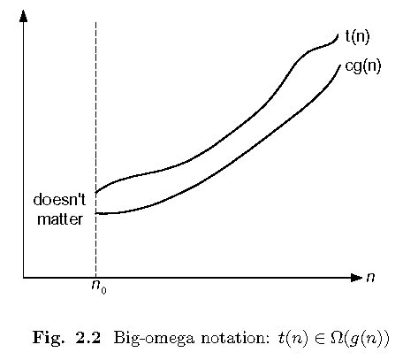
BIG OMEGA
Computer Science Department
Slide <number> of 56

Slide 41
BIG OMEGA
Constant
f(n) = 16 n=1
f(n) = 27 n=1
Linear
f(n) = 2n+3
f(n) = 7n+5
Quadratic
1) f(n) = 27n²+16n
2) f(n) = 27n²+16
3) f(n) = 27n²+16n +25
Cubic
f(n) = 2n³+n²+2n
2) f(n) = 4n³+2n+3
3) f(n) = 3n³+4n
Computer Science Department
Slide <number> of 56

Slide 42
BIG OMEGA
Exponential Function
f(n) = 2^{n} + 6n² +3n
f(n) = 4*2^{n} + 3n
f(n) = 5*2^{n} + 3n + 5
f(n) = 3*2^{n} + 4n²+5n+3
Computer Science Department
Slide <number> of 56

Slide 43
BIG THETA
Formal definition
  A function t(n) is said to be in Θ(g(n)), denoted t(n) ∈ Θ(g(n)), if t(n) is bounded both above and below by some positive constant multiples of g(n) for all large n, i.e., if there exist some positive constant c₁ and c₂ and some nonnegative integer n₀ such that
  c₂ g(n) ≤ t(n) ≤ c₁ g(n) for all n ≥ n₀
Check the following examples
  10n² ∈ Θ(n²)
  0.3n² - 2n ∈ Θ(n²)
  (1/2)n(n+1) ∈ Θ(n²)
Computer Science Department
Slide <number> of 56

Slide 44
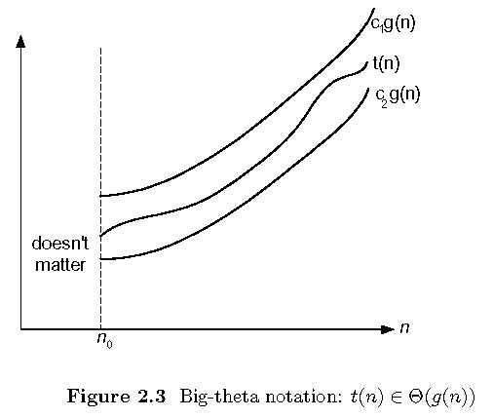
BIG THETA
Computer Science Department
Slide <number> of 56

Slide 45
BIG THETA
Constant
f(n) = 16
f(n) = 27
Linear
f(n) = 2n+3
f(n) = 7n+5
Quadratic
1) f(n) = 27n²+16n
2) f(n) = 10n²+7
3) f(n) = 27n²+16n +25
Cubic
f(n) = 2n³+n²+2n
2) f(n) = 4n³+2n+3
3) f(n) = 3n³+4n
Computer Science Department
Slide <number> of 56
Notes:
Constant
1)f(n) = 16
15*1 <= f(n) 16*1 c₁=15 c₂=16 n₀=0
2)f(n) = 27
26*1 <= f(n) 27*1 c₁=26 c₂=27 n₀=0
LINEAR
f(n) = 2n+3
2n<= 2n+3 c₁=2
2n + 3 <= 3n n>=3 c₁=3 n₀=3
2) f(n) = 7n+5
7n<= 7n+5 c₁=7
7n + 5 <= 8n n>=5 c₁=8 n₀=5

Slide 46
SOME PROPERTIES OF ASYMPTOTIC ORDER OF GROWTH
f(n) ∈ O(f(n))
f(n) ∈ O(g(n)) iff g(n) ∈Ω(f(n))
If f (n) ∈ O(g (n)) and g(n) ∈ O(h(n)) , then f(n) ∈ O(h(n))
Note similarity with a ≤ b
If f₁(n) ∈ O(g₁(n)) and f₂(n) ∈ O(g₂(n)) , then
f₁(n) + f₂(n) ∈ O(max{g₁(n), g₂(n)})
Also, Σ_{1≤i≤n} Θ(f(i)) = Θ (Σ_{1≤i≤n} f(i))
Computer Science Department
Slide <number> of 56

Slide 47
Establishing order of growth using limits
Examples:
10n vs. n²
n(n+1)/2 vs. n²
0 order of growth of T(n) < order of growth of g(n)
lim T(n)/g(n) =
c > 0 order of growth of T(n) = order of growth of g(n)
∞ order of growth of T(n) > order of growth of g(n)
Computer Science Department
Slide <number> of 56

Slide 48
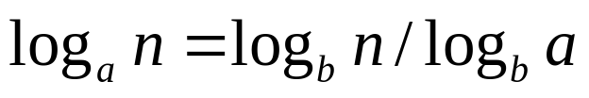
Orders of growth of some important functions
All logarithmic functions log_{a} n belong to the same class
Θ(log n) no matter what the logarithm’s base a > 1 is
because
All polynomials of the same degree k belong to the same class:
a_{k}n^{k} + a_{k-1}n^{k-1} + … + a₀ ∈ Θ(n^{k})
Exponential functions a^{n} have different orders of growth for different a’s
order log n < order n^{α} (α>0) < order a^{n} < order n! < order n^{n}
Computer Science Department
Slide <number> of 56

Slide 49
TIME EFFICIENCY OF NONRECURSIVE ALGORITHMS
GENERAL PLAN FOR ANALYSIS
Decide on parameter n indicating input size
Identify algorithm’s basic operation
Determine worst, average, and best cases for input of size n
Set up a sum for the number of times the basic operation is executed
Simplify the sum using standard formulas and rules
Computer Science Department
Slide <number> of 56

Slide 50
EXAMPLE
Give the Big O estimate for the number of operations used in the segment of an algorithm
t=0;
for i:= 1 to 3
for j := 1 to 4
t:=t +i*j
Computer Science Department
Slide <number> of 56
Notes:
O(1)

Slide 51
EXAMPLE
Give the Big O estimate for the number of operations is comparison or a multiplication
used in this segment of an algorithm(ignoring comparisons in the for loops)
t=0;
for i:= 1 to n
for j := i+1 to n
t:=max(a_{i},a_{j},t)
Computer Science Department
Slide <number> of 56
Notes:
O(n²)

Slide 52
Useful Summation Formula and Rules
Σ_{l≤i≤n}1 = 1+1+…+1 = n - l + 1
In particular, Σ_{l≤i≤n}1 = n - 1 + 1 = n ∈ Θ(n)
Σ_{1≤i≤n} i = 1+2+…+n = n(n+1)/2 ≈ n²/2 ∈ Θ(n²)
Σ_{1≤i≤n} i² = 1²+2²+…+n² = n(n+1)(2n+1)/6 ≈ n³/3 ∈ Θ(n³)
Σ_{0≤i≤n} a^{i} = 1 + a +…+ a^{n} = (a^{n+1} - 1)/(a - 1) for any a ≠ 1
In particular, Σ_{0≤i≤n} 2^{i} = 2⁰ + 2¹ +…+ 2^{n} = 2^{n+1} - 1 ∈ Θ(2^{n} )
Σ(a_{i} ± b_{i} ) = Σa_{i} ± Σb_{i} Σca_{i} = cΣa_{i} Σ_{l≤i≤u}a_{i} = Σ_{l≤i≤m}a_{i} + Σ_{m+1≤i≤u}a_{i}
Computer Science Department
Slide <number> of 56

Slide 53
EXAMPLE
for (i=0; i< 2*n; i+=2) { //1
for(j=n; j>I; j--) { //2
foo(); //3
}
}
Computer Science Department
Slide <number> of 56

Slide 54
MAXIMUM ELEMENT
Algorithm MaxElement (A[0..n-1])
//Determines the value of the largest elements in a given array
//Input: An array (A[0..n-1]) of real numbers
//Output: The value of the largest element in A
maxval ← A[0]
for i ← to n-1 do
if A[i] > maxval
maxval ← A[i]
return maxval
T(n) = 1in-1 1 = n-1 = (n) comparisons
Computer Science Department
Slide <number> of 56

Slide 55

UNIQUENESS PROBLEM
Algorithm UniqueElements (A[0..n-1])
//Determines whether all the elements in a given array are distinct
//Input: An array (A[0..n-1])
//Output: Return “true” if all the elements in A are distinct and “false” otherwise
for i ← to n-2 do
for j ← i + 1 to n-1 do
if A[i]=A[j] return false
return true
T(n) = 0in-2 (i+1jn-1 1)
= 0in-2 n-i-1 = (n-1+1)(n-1)/2
= ( ) comparisons
Computer Science Department
Slide <number> of 56

Slide 56
?
Computer Science Department
Slide <number> of 56

